Slide 1
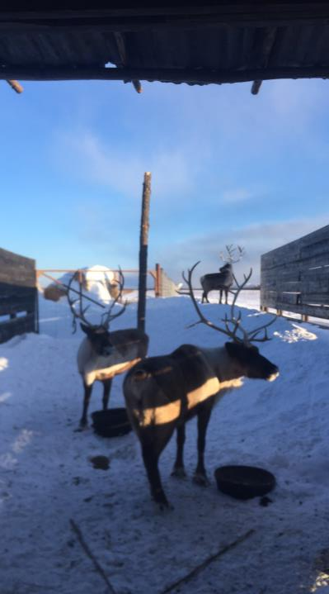
Stevens Village Bison Farm
A Sustainable Tribal Agriculture Project
to
promote Alaskan
Health, Wellbeing, & Food Sovereignty

Slide 2
Centrally Located

Slide 3
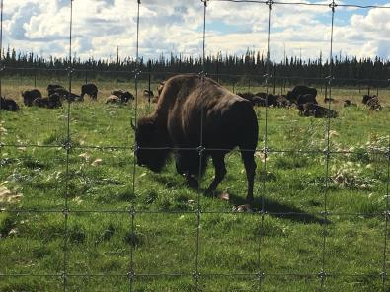
The Farm Our Goal: Promote Alaskan Health, Wellbeing, & Food Sovereignty
produce healthy food for Alaskans
generate sustainable Tribal income and employment
provide agricultural research/educational opportunities

Slide 4
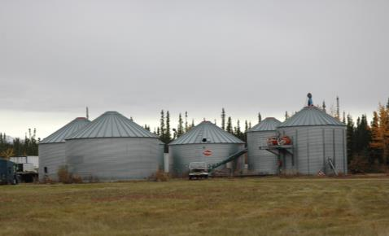
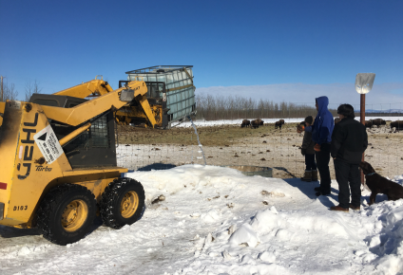
The Farm
Plains Bison Herd (~150)
Reindeer Demonstration Project (4)
2,000 acres of fenced pasture with a corral and shoots, grain bins, assorted equipment

Slide 5
Our Philosophy
Tribally owned & operated
Healthy animals
Work with what we have

Slide 6
Possibilities

Slide 7
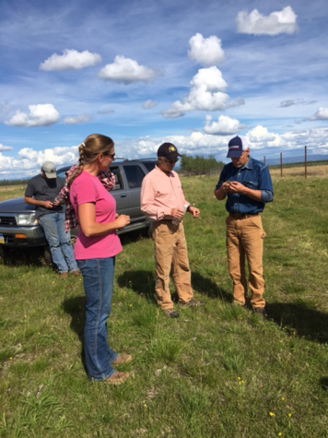
Partners
University of Alaska Fairbanks
Reindeer Research Program
University of Alaska Anchorage
Business Enterprise Institute
USDA
Natural Resources Conservation Service
Tanana Chiefs Conference
Notes:
USDA and Natural Resources Conservation Service, NRCS and our programs. Under EQIP the Environmental Quality Incentive Program, the farm has done the conservation practices of prescribed grazing, reseeding, wells, solar for the wells, pipelines, watering facilities, heavy use area protection, nutrient management and pest management and fence.

Slide 8
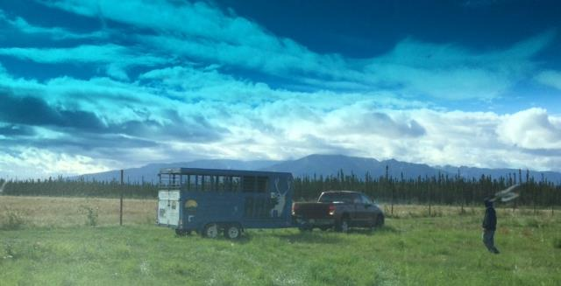
Reindeer Demonstration Project
Notes:
Demo Project implementation: Greg Finstad, Erin and George pulling up to the SVS Delta Farm with reindeer. August, 2016.

Slide 9
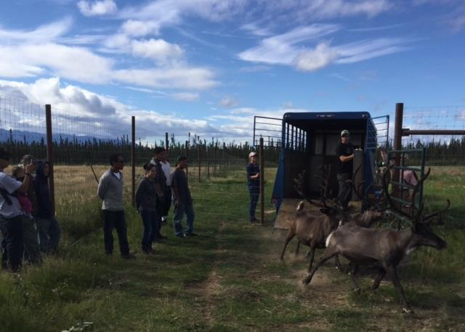
Reindeer Demonstration Project
Notes:
And, they’re off…!!

Slide 10
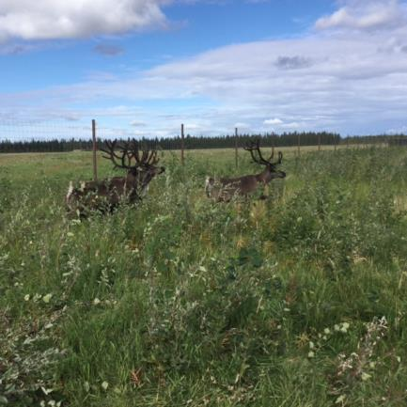
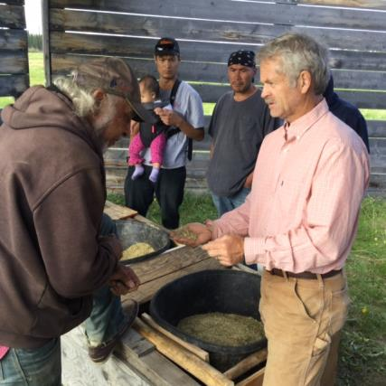
Reindeer Demonstration Project
Notes:
And, they’re off…!!

Slide 11
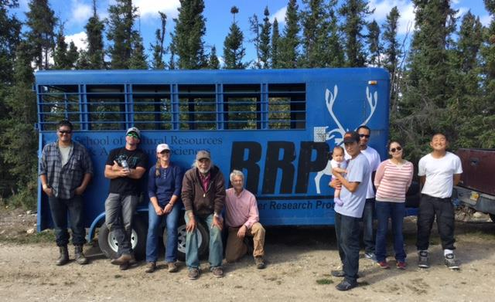
Reindeer Demonstration Project
Notes:
And, they’re off…!!

Slide 12
Feasibility Study
Estimated carrying capacity 2,000
2010 census of agriculture Alaska reindeer herders produced more than 210,000 pounds of meat annually valued at $780,000 from around 15,000 animals ($160,000 byproducts).

Slide 13
Feasibility: Strengths
Compliment bison operation
Location & access to markets
High demand in Alaska and nationally
Pasture/facilities are ideal for raising reindeer
Partnerships
UAF has extensive knowledge
Potential with Western Reindeer Herders

Slide 14
Feasibility: Weaknesses
Time and money
Existing market is small
Slaughter and processing facility
Management experience

Slide 15
Thank You
Ben Stevens
benjamin.stevens@tananachiefs.org

